Slide 1
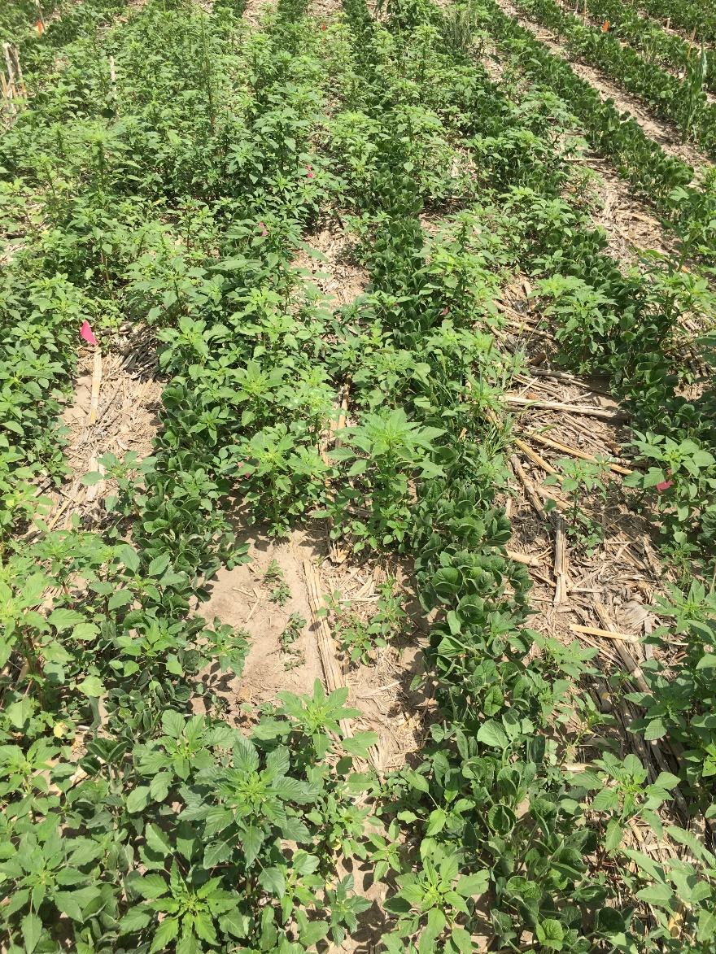
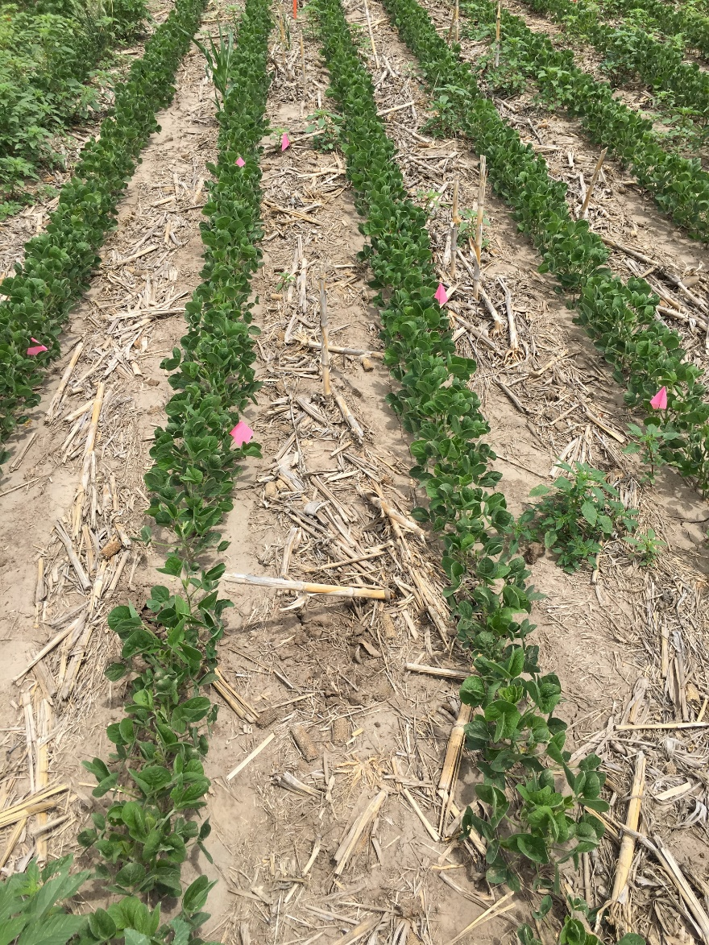
McCook, NE
NO PRE (6 WAP)
YES PRE (GROUPS 14+5; 6 WAP)
Pictures taken at 6 weeks after planting (WAP). This Nebraska study demonstrates the impact of PRE-emergence herbicides on control of Palmer amaranth in soybeans.

